Slide 3
Type
Sedan
Sedan
Police
SUV
SUV
Hatchback
Van
MiniVan
Van
Taxi
Bus
Truck including Truck Pickup, Truck Box Med, Truck Box Large, Truck Flatbed, and Truck Util

Slide 4
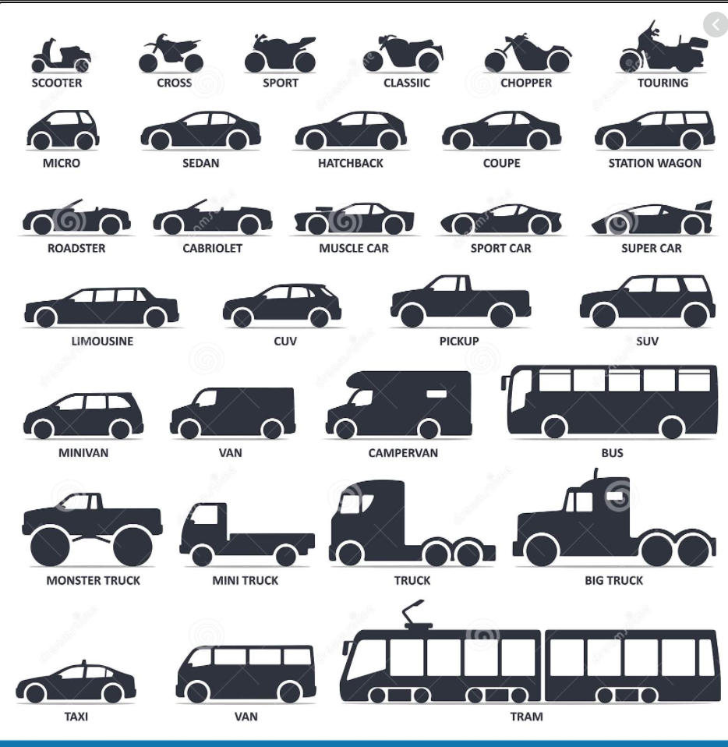

Slide 5
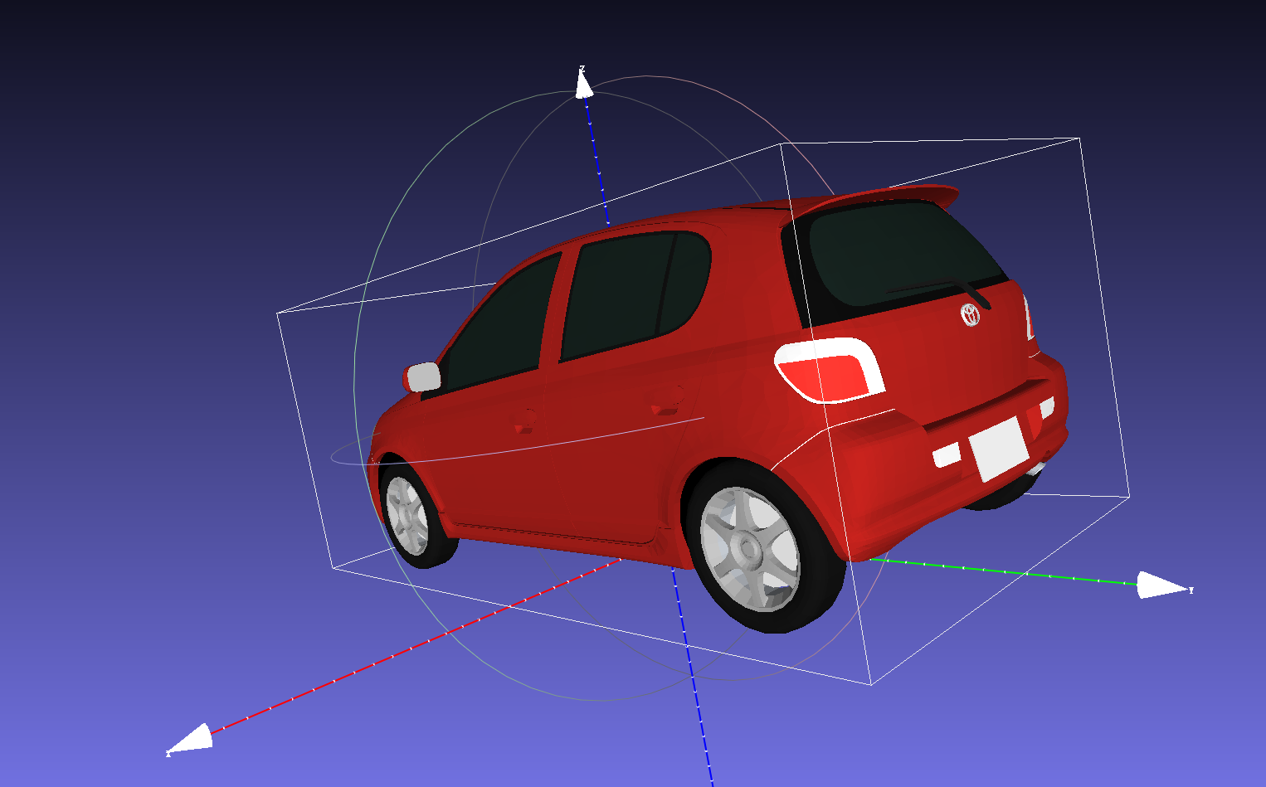

Slide 6
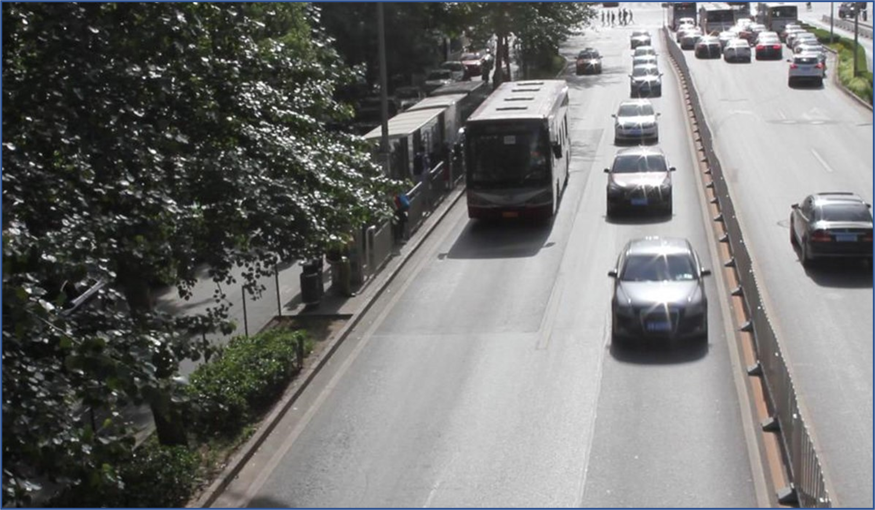

Slide 7
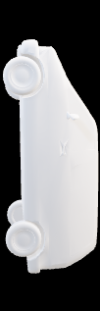

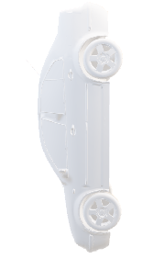
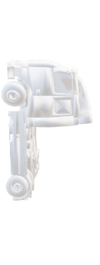
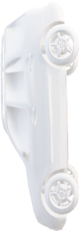
Type | Length | Width | Height | 3D Model
Car | 4.4 | 1.9 | 1.6
SUV | 5.2 | 2.1 | 1.9
Bus | 10.5 | 2.6 | 3.2
Truck | 5.8 | 3.0 | 3.3
VAN | 5.2 | 2.5 | 2.2

